Slide 1


All Things Ansible
The good, the bad and the ut oh I just wiped out prod…

Slide 2


Slide 3
About us
Darren Young
youngd24@gmail.com
Security Operations Manager
iManage
25+ years in tech (15 in security)
Jack of many, master of Google
B.S. C.S, MBA, CISSP
Splunk Certified
Formerly M$, RedHat, Sun, Cisco, Juniper and a number of others certified
I like hot sauce
Juan Munoz
munozjuanjose@Outlook.com
Cloud Security Engineer
iManage
4 years in Tech
Splunk Guy – give us all your logs
B.S in Information Technology
Previously an I.T. Auditor (joined the dark side)

Slide 4
contents
Part 1
History
Overview
Installation
Configuration
Inventory
Configuration
State Management
Playbooks
Privilege escalation
Vault
Part 2
Facts & Vars
Conditionals
Templates
Execution
Logging
Advanced Usage
Handlers
Tags
Roles
Modules
integrations

Slide 5


Slide 6

Configuration Management
A process for establishing and maintaining consistency of a product's performance, functional, and physical attributes with its requirements, design, and operational information throughout its life
Widely used by military engineering organizations to manage changes throughout the system lifecycle of complex systems, such as weapon systems, military vehicles, and information systems
Outside the military, the CM process is also used with IT service management as defined by ITIL, and with other domain models in the civil engineering and other industrial engineering segments such as roads, bridges, canals, dams, and buildings
https://en.wikipedia.org/wiki/Configuration_management

Slide 7
The New Kid In School
1993 CFEngine
1998 PIKT
2005 Puppet
2009 Chef
2011 Salt
2012 Ansible
https://en.wikipedia.org/wiki/Comparison_of_open-source_configuration_management_software

Slide 8

Key Takeaways
This isn't new
M$ tried this with PowerShell DSC (and failed)

Slide 9

Overview

Slide 10
What it is
From Wikipedia: “Ansible is an open-source software provisioning, configuration management, and application-deployment tool enabling infrastructure as code”
A (mainly python based) tool for automated configuration management to control your world
Created by Michael DeHaan, released 2012
Open Source (and commercial)
Acquired by RedHat in 2015
https://en.wikipedia.org/wiki/Ansible_(software)
https://en.wikipedia.org/wiki/Configuration_management

Slide 11

What it isn’t
An image build tool
An orchestration tool
A scripting language
A nuclear weapon (Terraform can claim that)

Slide 12

RedHat Acquired Ansible in 2015 (for more than all of us make)

Slide 13
Licensing
Open Source
https://github.com/ansible/ansible
Commercial
https://www.ansible.com/products/tower/editions

Slide 14

Use Cases (e.g. what the hell do I use this thing for?)
Base OS Config
Installing Applications (Splunk, Docker, etc)
Security Hardening (CIS Compliance)
Patching (supports various package mangers)
Vulnerability remediation
Padding your resume

Slide 15
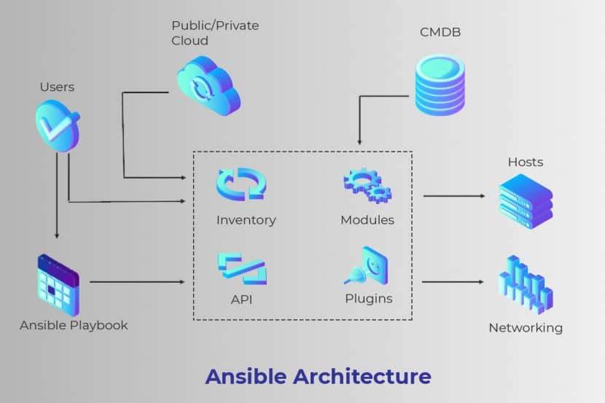

Slide 16

Push Vs. Pull Model
Push Model
Pull Model
Central Server delivers the desired configuration to the nodes
Pros
Firewall rules
Central control & logging
Faster setup
Cons
Limitations on scalability
Scheduled updates
Nodes periodically check in to see if any configuration changes are needed
Pros
Clients are almost real-time updated
Can be more scalable than pull
Cons
Client software needed
Limited logging visibility for troubleshooting
Firewall rules

Slide 17

Authentication
SSH *Must* be configured and working for Ansible to operate (on *NIX)
Key based authentication preferred but password based possible
Windows uses WinRM w. Kerberos (some NTLM)
Recommendation is to use a dedicated automation account

Slide 18

Installation

Slide 19

Assumptions
Controller is a *NIX machine (Linux in these examples)
Separate service account used for automation communications
Managed systems have existing working SSH (key based auth) or WinRM
Managed systems are a mix of *NIX and Windoze

Slide 20

Controller
Just another *nix machine
Ansible installed locally
Might have access to a CMDB or other external inventory source
Can be run on Windoze (but, like, don’t, please)
Must have ssh access (or WinRM for dozers) to all managed machines

Slide 21

Controller Installation
yum install ansible
apt-get install ansible
Yes, that’s it…

Slide 22

Managed node installation
Quiz: what’s needed on a managed node?
Alternate question: how many windows digs have we gotten in so far?

Slide 23
Spin up lab
git clone https://github.com/youngd24/vagrant-ansible-lab
cd vagrant-ansible-lab
vagrant plugin install vagrant-hostmanager
vagrant up
vagrant ssh control

Slide 24

Configuration

Slide 25


You must learn YAML (today)
Rules:
Everything (mostly) in Ansible is YAML (or json, or python, or ini files)
Ok, so not everything..
YAML is poor man’s JSON
YAML sucks
See rule #1

Slide 26

Inventory Management
The inventory file is the “heart” of Ansible, it describes managed systems, groups they are in and various attributes (variables) about them
Is in ini-file format but can also be yaml (or json)
Can be built dynamically from external sources
Third party CMDB (Salesforce, Service Now)
AWS/Azure
<insert random API here>
Several modules ship with
https://docs.ansible.com/ansible/latest/user_guide/intro_inventory.html

Slide 27
Inventory Groups
Groups are used to group hosts together into logical sections to manage more than one host at a time
2 default groups
all – contains every host
ungrouped – hosts that don’t have a group other than ‘all’
Hosts can be in multiple groups as well as nested groups
Can assign hosts using ranges (www[01:50])

Slide 28
Example Inventories (ini file)
[loadbalancer]
lb01
[webserver]
app01
app02
[database]
db01
[control]
control ansible_connection=local
[loadbalancer]
lb01
[webserver]
app01
app02
[database]
db01
[control]
control ansible_connection=local
[myapp:children]
loadbalancer
webserver
database
Single
Nested

Slide 29
ansible-inventory --help
vagrant@control:/vagrant/ansible$ ansible-inventory -i hosts --graph
@all:
|--@control:
| |--control
|--@database:
| |--db01
|--@loadbalancer:
| |--lb01
|--@ungrouped:
|--@webserver:
| |--app01
| |--app02
vagrant@control:/vagrant/ansible$ ansible-inventory -i hosts.nested-groups --graph
@all:
|--@control:
| |--control
|--@myapp:
| |--@database:
| | |--db01
| |--@loadbalancer:
| | |--lb01
| |--@webserver:
| | |--app01
| | |--app02
|--@ungrouped:

Slide 30
Ansible Configuration
Main configuration file is ansible.cfg
Default installation places one in /etc/ansible
Search order
ANSIBLE_CONFIG (environment variable if set)
ansible.cfg (in the current directory)
~/.ansible.cfg (in the home directory)
/etc/ansible/ansible.cfg (system file)
Command line arg to point to an alternate ansible.cfg
Contains a metric ton of configuration options
(Hint: use the defaults Luke, use the defaults)
https://docs.ansible.com/ansible/latest/reference_appendices/config.html

Slide 31
ansible-config --help
vagrant@control:/vagrant/ansible$ cat ansible.cfg
[defaults]
inventory = ./hosts
vault_password_file = ~/.vault_pass.txt
vagrant@control:/vagrant/ansible$ ansible-config --help
usage: ansible-config [-h] [--version] [-v] {list,dump,view} ...
View ansible configuration.
positional arguments:
{list,dump,view}
list Print all config options
dump Dump configuration
view View configuration file
optional arguments:
--version show program's version number, config file location,
configured module search path, module location, executable
location and exit
-h, --help show this help message and exit
-v, --verbose verbose mode (-vvv for more, -vvvv to enable connection
debugging)

Slide 32
Verify Operations
control | SUCCESS => {
"ansible_facts": {
"discovered_interpreter_python": "/usr/bin/python"
},
"changed": false,
"ping": "pong"
}
db01 | SUCCESS => {
"ansible_facts": {
"discovered_interpreter_python": "/usr/bin/python"
},
"changed": false,
"ping": "pong"
}
app01 | SUCCESS => {
"ansible_facts": {
"discovered_interpreter_python": "/usr/bin/python"
},
"changed": false,
"ping": "pong"
}
lb01 | SUCCESS => {
"ansible_facts": {
"discovered_interpreter_python": "/usr/bin/python"
},
"changed": false,
"ping": "pong"
}
Ansible ping example in lab

Slide 33

Make it work

Slide 34

What is “state”?
Most Ansible modules check whether the desired final state has already been achieved and exit without performing any actions if that state has been achieved
repeating the task does not change the final state
Modules that behave this way are often called ‘idempotent’
Idempotent (adjective): denoting an element of a set which is unchanged in value when multiplied or otherwise operated on by itself
Run a playbook once, or multiple times, the outcome should be the same
Not all playbooks and not all modules behave this way
Test playbooks in a sandbox before running them multiple times in production
Most apt comparison: rsync

Slide 35

The Playbook
The core of all Ansible work
Essentially a To-Do List written in YAML
Composed of one or more plays
A Play will target a desired set of machines with specific set of tasks or steps

Slide 36

Hosts
Must be hosts defined in the selected inventory
Can be hosts
Can also be groups

Slide 37

Tasks
By default, Ansible executes each task in order, one at a time, against all machines matched by the host pattern using 5 forks
Each task executes a module with specific arguments
When a task has executed on all target machines, Ansible moves on to the next task
Can increase the number of forks
You can use strategies to change this default behavior (the linear strategy)
Debug strategy (self-explanatory)
Free strategy (doesn’t wait on other hosts)

Slide 38
Example Playbook
--- ############################################################################## # # Basic playbook # ##############################################################################
- name: basic_playbook hosts: all
tasks: - name: ensure apache2 is installed apt: name: apache2 state: present
https://docs.ansible.com/ansible/latest/collections/ansible/builtin/apt_module.html

Slide 39
Playbook example
Run lab examples here
Show output, blah blah blah

Slide 40


Slide 41

Privilege escalation
Become
set to yes to activate privilege escalation
Become_user
set to user with desired privileges (the user you become, NOT the user you login as)
Does NOT imply become: yes, to allow it to be set at host level
Default value is root
Become_method
At play or task level overrides the default method set in ansible.cfg
set to use any of the become plugins (su, sudo or doas).
CLI options
--become
--become_user
--become_method
https://docs.ansible.com/ansible/latest/user_guide/become.html

Slide 42

Privilege escalation
Risks
Playbooks have elevated privs, secure the controller
Store passwords in vault(s)
It’s root, remember this
Limitations
Not supported by all plugins
Only one method per host
Must be general
https://docs.ansible.com/ansible/latest/user_guide/become.html

Slide 43

Privilege escalation – Network
As of version 2.6, Ansible supports become for privilege escalation (entering enable mode or privileged EXEC mode) on all Ansible-maintained network platforms that support enable mode
Using become replaces the authorize and auth_pass options in a provider dictionary.
You must set the connection type to either connection: ansible.netcommon.network_cli or connection: ansible.netcommon.httpapi to use become for privilege escalation on network devices
You can use escalated privileges on
only the specific tasks that need them
on an entire play
on all plays
Adding become: yes and become_method: enable instructs Ansible to enter enable mode before executing the task, play, or playbook where those parameters are set.
https://docs.ansible.com/ansible/latest/user_guide/become.html#become-and-network-automation

Slide 44
Privilege Escalation example
Lab example
https://docs.ansible.com/ansible/latest/collections/ansible/builtin/apt_module.html

Slide 45

End of …

Slide 46


Slide 47

Ansible Vault
Ansible Vault encrypts variables and files so you can protect sensitive content such as passwords or keys rather than leaving it visible as plaintext in playbooks or roles
To use Ansible Vault you need one or more passwords to encrypt and decrypt content
https://docs.ansible.com/ansible/latest/user_guide/vault.html

Slide 48

Ansible Vault - Configuration
Add stuff here to show how to create, store and use vault
Show the config in the lab

Slide 49
VAULT: Example
- name: Encrypt the ssh private key
local_action: " shell ansible-vault encrypt --vault-password-file ~/.vault_pass.txt ../files/admin"
delegate_to: localhost
become: no
no_log: true

Slide 50

Responding to your environment
Facts, vars and conditionals
Where Ansible approaches being a language and not a tool

Slide 51

Variables

Slide 52
Vars: description
Ansible uses variables to manage differences between systems
With Ansible, you can execute tasks and playbooks on multiple different systems with a single command
To represent the variations among those different systems, you can create variables with standard YAML syntax, including lists and dictionaries
You can define these variables in your playbooks, in your inventory, in re-usable files or roles, or at the command line
You can also create variables during a playbook run by registering the return value or values of a task as a new variable
After you create variables, either by defining them in a file, passing them at the command line, or registering the return value or values of a task as a new variable, you can use those variables in module arguments, in conditionals, in templates, and in loops
https://docs.ansible.com/ansible/latest/user_guide/playbooks_variables.html
https://github.com/ansible/ansible-examples

Slide 53

Vars: What’s in a name…
Not all strings are valid Ansible variable names
A variable name can only include letters, numbers, and underscores
Python keywords or playbook keywords are not valid variable names
A variable name cannot begin with a number
Variable names can begin with an underscore
These are NOT private or “local” variables, do not treat them as such
https://docs.python.org/3/reference/lexical_analysis.html#keywords
https://docs.ansible.com/ansible/latest/reference_appendices/playbooks_keywords.html#playbook-keywords

Slide 54

Vars: setters and getters
Set simple variables in YAML using the syntax ‘var: foo’
Access using the Jinja2 syntax, as in {{ var }}

Slide 55
Vars: simple example
---
- name: simple_var
hosts: app01
become: yes
vars:
#set the variable
remote_install_path: /opt/my_app_config
tasks:
- name: Return the set install path
debug:
msg: path {{ remote_install_path }}

Slide 56

Vars: “Quoting”
If you start a value with {{ foo }}, you must quote the whole expression to create valid YAML syntax
If you do not quote the whole expression, the YAML parser cannot interpret the syntax - it might be a variable or it might be the start of a YAML dictionary
https://docs.ansible.com/ansible/latest/reference_appendices/YAMLSyntax.html#yaml-syntax

Slide 57

Vars: Lists
A list variable combines a variable name with multiple values
The multiple values can be stored as an itemized list or in square brackets [], separated with commas
Remember, the world starts at 0, not 1

Slide 58
Vars: Using Lists
---
- name: simple_list
hosts: app01
become: yes
vars:
#set the variable
region:
- northeast
- southeast
- midwest
confused: [ 'Whiskey', 'Bourbon', 'Scotch' ]
tasks:
- name: Print our first list
debug:
msg: “region {{ region[0] }}"
- name: The drink of choice
debug:
msg: “Drink {{ confused[2] }}"

Slide 59

Vars: Dictionaries
Stores data in key-value pairs
Changeable, indexed and unordered
Can be nested
Example: ansible.builtin.shell
Every value has a name(key)
Not indexed by their positional values like 0,1,2, etc
My personal favorite variable type as it allows categorization of configuration data in a structured format
https://docs.ansible.com/ansible/devel/collections/ansible/builtin/dict_lookup.html

Slide 60
Vars: Using Dictionaries
---
- name: simple_dict
hosts: app01
become: yes
vars:
#set the variable
debug: "true"
tasks:
- name: Print the log level
debug:
msg: “Debug is set to {{ debug }}”

Slide 61
Vars: Using Nested Dictionaries
--- # # simple_nest_dict.yml # # Set the dictionary logging: level: debug file: name: app.log path: /var/log owner: myapp # print the log level - debug: msg: “logging level {{ logging.level }}” # print the log file (note []) - debug: msg: “logging file {{ logging.file.path }}”

Slide 62

Vars: Levels
You can define variables at many levels:
Playbook
Inventory
host_vars
group_vars
On the command line

Slide 63

Order of Precedence
command line values
role defaults
inventory file or script group vars
inventory group_vars/all
playbook group_vars/all
inventory group_vars/*
playbook group_vars/*
inventory file or script host vars
inventory host_vars/*
playbook host_vars/*
host facts / cached set_facts
play vars
play vars_prompt
play vars_files
role vars (defined in role/vars/main.yml)
block vars (only for tasks in block)
task vars (only for the task)
include_vars
set_facts / registered vars
role (and include_role) params
include params
extra vars (for example, -e "user=my_user")(always win precedence)
The order of precedence from least to greatest (the last listed variables override all other variables)

Slide 64

Just the facts

Slide 65
Facts
With Ansible you can retrieve or discover certain variables containing information about your remote systems or about Ansible itself
Variables related to remote systems are called facts including operating systems, IP addresses, attached filesystems, and more
With facts, you can use the behavior or state of one system as configuration on other systems
For example, you can use the IP address of one system as a configuration value on another system
You can access this data in the ansible_facts variable
By default, you can also access some Ansible facts as top-level variables with the ansible_ prefix. You can disable this behavior using the inject_facts_as_vars setting
Variables related to Ansible are called magic variables
https://docs.ansible.com/ansible/latest/user_guide/playbooks_vars_facts.html

Slide 66
Gather Facts Example
ansible -m setup app01
Gather Facts from the command Line

Slide 67
Vars/Facts lab run
---
- name: vars_playbook hosts: webservers remote_user: vagrant become: yes
become_user: root
vars:
user: admin
tasks:
- name: Add the user 'admin' with a bash shell, appending the group 'adm'
user:
name: "{{ user }}"
shell: /bin/bash
groups: adm
append: yes
- name: Return users part of adm
shell: cat /etc/group | grep -w adm
register: group_results
- name: Gathering ansible facts
debug:
msg: Users found in adm group for {{ inventory_hostname }} is {{ group_results.stdout }}

Slide 68

Conditionals

Slide 69
Conditionals
In a playbook, you may want to:
Execute different tasks
Have different goals, depending on the value of a fact, a variable, or the result of a previous task.
Like traditional “if-then-else” syntax in other languages (AKA conditional branching).
You may want the value of some variables to depend on the value of other variables.
Ansible uses Jinja2 tests and filters in conditionals.
Ansible supports all the standard tests and filters and adds some unique ones as well.

Slide 70
Example Conditionals in a playbook
---
- name: Patch systems
hosts: patch
become: yes
tasks:
- name: upgrade all packages for RedHat systems
yum:
name: '*'
state: latest
when: ansible_facts['os_family'] == "RedHat"
- name: Upgrade all packages for Debian systems
apt:
name: "*"
state: latest
when: ansible_facts['os_family'] == "Debian"

Slide 71

Templating
Jinja2
Ability to add dynamic variables to our config files
The language processing your template files in Ansible
Identifited easily by the j2 extension
Limitations
Examples
Refer to Lab Slides

Slide 72
Template examples
<html>
<center>
<h1> The hostname of this webserver
is {{ ansible_hostname }}</h1>
<h3> It is running on {{ ansible_os_family }} system </h3>
</center>
</html>
---
- name: template_playbook
hosts: webserver
remote_user: vagrant
become: yes
become_user: root
tasks:
- name: ensure base apache package is installed
apt:
pkg:
- apache2
- name: Install index.html
template:
src: "../templates/index.html.j2"
dest: /var/www/html/index.html
mode: 0777
- name: restart the apache service
service:
name: apache2
state: restarted

Slide 73

Execution

Slide 74

Ansible execution – command options
Commands
ansible
ansible-config
ansible-console
ansible-galaxy
ansible-playbook
ansible-test
ansible-connection
ansible-doc
ansible-inventory
ansible-pull
ansible-vault

Slide 75

Execution
The majority of the ansible* commands share the same command line arguments
Until they don’t
The most commonly used ones are ansible and ansible-playbook

Slide 76

ansible-lint --help
Separate installation (community supported package)
ansible-lint is your friend
Use early, use often
Ideally in your CI/CD pipelines on commit/push
Lets you know about common issues and errors (syntax, module, etc)
Operates recursively across files/directories/roles
Many “factory” supplied rules: https://ansible-lint.readthedocs.io/en/latest/default_rules.html
has options for suppressing messages:
skip_list:
- '204'
- '305’
Lab example
https://github.com/ansible-community/ansible-lint

Slide 77

ansible-docs --help
Used to generate docs for your playbook/role/module in html/pdf/json and other formats
Leverages the Ansible docs format, which is based (at least partially) on the Python doc format
Allows you to “self-document” your code
Automated HTML doc generation in your CI/CD pipeline tool (very make friendly)
https://docs.ansible.com/ansible/2.5/dev_guide/developing_modules_documenting.html

Slide 78

ansible-pull --help
Reverses the default ansible push method to be pull based
Requires git to be installed
Automatically does a ‘git clone’ of a repository then runs a playbook from it
Useful when scheduled ansible runs are needed (from cron for example)
Does not require inbound SSH access, uses HTTP(s) via git

Slide 79

ansible-console --help
Nifty interactive ansible console
Runs ad-hoc commands and modules against hosts/groups in a given inventory file
Useful for things like “run the df command on all hosts” or similar
Lab example
ansible-console df -h

Slide 80

Logging

Slide 81

logging

Slide 82

File Logging
By default, Ansible sends output about plays, tasks, and module arguments to your screen (STDOUT) on the control node.
If you want to capture Ansible output in a log, you have three options:
To save Ansible output in a single log on the control node, set the log_path config file setting.
You may also want to set display_args_to_stdout, which helps to differentiate similar tasks by including variable values in the Ansible output.
To save Ansible output in separate logs, one on each managed node, set the no_target_syslog and syslog_facility config file settings.
To save Ansible output to a secure database, use Ansible Tower. Tower allows you to review history based on hosts, projects, and particular inventories over time, using graphs and/or a REST API.

Slide 83
Suppressing logging
---
- name: secret stuff
command: "echo {{secret_root_password}} | sudo su -"
no_log: true

Slide 84

More Advanced Playbook settings
Handlers
Includes
Role
Playbook

Slide 85

Handlers
Sometimes you want a task to run only when a change is made on a machine.
For example, you may want to restart a service if a task updates the configuration of that service, but not if the configuration is unchanged.
Ansible uses handlers to address this use case.
Handlers are tasks that only run when notified.
Each handler should have a globally unique name.

Slide 86
Handler Example
---
- name: Verify apache installation hosts: webserver vars: http_port: 80 max_clients: 200 remote_user: root
tasks:
- name: Ensure apache is at the latest version
ansible.builtin.yum:
name: httpd
state: latest
- name: Write the apache config file
ansible.builtin.template:
src: /srv/httpd.j2
dest: /etc/httpd.conf
notify:
- Restart apache
- name: Ensure apache is running
ansible.builtin.service:
name: httpd
state: started
handlers:
- name: Restart apache
ansible.builtin.service:
name: httpd
state: restarted

Slide 87
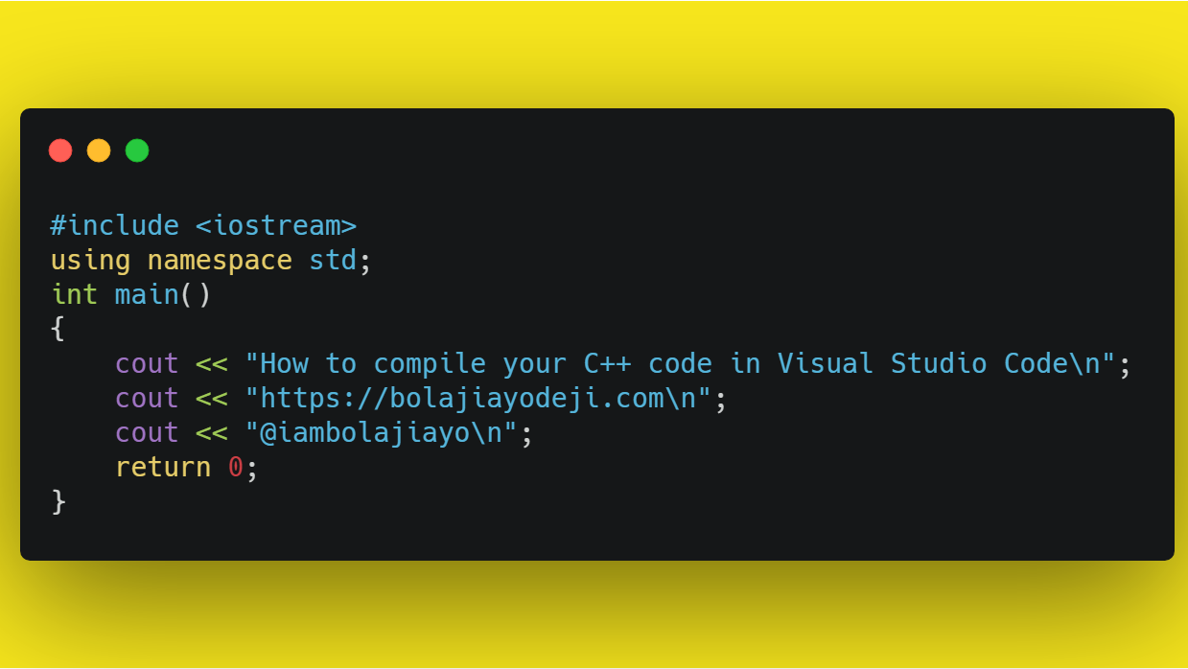
#include
Include a role
Import another playbook

Slide 88
Include Role
- name: base-os
hosts: all
any_errors_fatal: true
become: yes
tasks:
# DNS resolution
- include_role:
name: resolv.conf
# Deal with the messed up base image
- include_role:
name: ca-cert-reinstall

Slide 89
Import Playbook
- name: splunk-lgh
hosts: all
any_errors_fatal: true
become: yes
- name: import base-os
import_playbook: base-os.yml
- name: import splunk-core
import_playbook: splunk-core.yml
- name: splunk-loghost
hosts: all
become: yes
tasks:
- include_role:
name: splunk-loghost

Slide 90

Roles
Creating
Get the basic role structure from the ansible-galaxy init <role_name>
Or do it manually
Using
Command line
Via include_role

Slide 91

Standard structure
defaults
Files
Handlers
Meta
Tasks
Templates
Vars

Slide 92

Ansible Galaxy
Essentially a “meta” role
Metadata.yml file
Can be used publicly or hosted internally as your own “Galaxy”
Or … Run your own Galaxy server
https://training.galaxyproject.org/training-material/topics/admin/tutorials/ansible-galaxy/tutorial.html

Slide 93

Modules
Use modules to write Ansible native code
Standard API offered to write around that implements the “only when changed” methodology.
All of Ansible has been implemented as modules.
Use the dev version of Ansible to develop new modules.
All Python based.

Slide 94

The End

